Slide 1
IDENTIFICATION AND ANALYSIS OF DESCRIPTIVE OPINION SPAM
End Semester Evaluation: 28th April 2015
Supervised by – Dr Ratna Sanyal
Shubham Sharma (IIT2012134) Ronish Kalia (IIT2012139) Shubham Mehrotra (IIT2012156)
Dhruv Kumar (IIT2012171) Pankaj Wadhwani (IIT2012174) Arjun Banga (IIT2012183)

Slide 2
Objective
We were previously working on a project that dealt with the opinion farming of the customer reviews.
We found that the reviews were not coherent with the final output of our study.
By finding out which feature has the largest number of spam reviews in it, we would able to indicate which features are thought to influence the users in the most impactful way.
This generated data could be used by a company for the better marketing and promotion of the product.

Slide 3
Reasons For Spamming
Spammers work usually for profits, may have connection with the stores.
Spammers are usually hired by brands hungry for publicity as they stronger motivation.
Brands with good reputations and stable customer traffic may not hire spammers at all; since they lose much more if they are caught doing so.
Spams could be either positive reviews about lousy stores, or negative reviews about good stores.
Not all reviews deviating from mainstream are spam.

Slide 4
Analysis of our Review Dataset
Identification of Spam Using
Token Identification
Shingling
Bayesian Classifier
Using user review history
Hybrid Method
Improved Review Dataset
Analysis on Improved Dataset

Slide 5
Previous Workflow
REVIEW EXTRACTION
POS TAGGING
FEATURE EXTRACTION
MULTI DOCUMENT CATEGORIZATION
OPINION ANALYSIS

Slide 6
Literature Survey
Spam detection based on biometric analysis.
Detection based on the depth of the review. More detailed review has greater chances of being true.
Observing the writing style and the level of emotions of the reviewer.
Make association rules and then estimate the degree of truth of the sentence.
Calculate standard deviation from the overall review.

Slide 7
Our Dataset
The Amazon Mechanical Turk (MTurk) is a crowdsourcing Internet marketplace that enables individuals and businesses (known as Requesters) to coordinate the use of human intelligence. The Requesters are able to post tasks known as HITs (Human Intelligence Tasks).
40% of New Mechanical Turkers' Work Requests Are Now For Spamming
Yelp dataset consisting of User, Product and Time details.

Slide 8
Removal of Common Spam Words
This technique eliminates the most trivial type of spams that a user may encounter on an E Commerce website.
We search if the reviews have any vulgar content or are misleading to the user.
The reviews could also be used to publicize certain set of websites and could also be used to dupe customers.
We have used a combination of words like share, follow, subscribe, click, etc. to identify these type of reviews. All the reviews that contain these words are marked as spam.

Slide 9
Shingling Algorithm:
Shingling algorithm is used to detect duplicate and near-duplicate spam reviews.
Given a positive integer K and a sequence of terms in a review D, define the k-shingles of D to be the set of all consecutive sequences of k terms in D.
Let S(d_{j}) denote the set of shingles of review d_{j}. The degree of similarity between two reviews d1 and d2 is defined by Jaccard Coefficient.
J(S(d₁), S(d₂)) = |S(d₁) intersection S(d₂) / S(d₁) union S(d₂)|
If this coefficient is greater than a particular threshold, then the reviews are spam else not.

Slide 10
Shingling Algorithm (Example) :
For Example :
Consider the following text:
a rose is a rose is a rose.
The 4-shingles for this text ( K = 4 is a typical value used in the detection of near-duplicate reviews) are :
{“a rose is a”}x2, {“rose is a rose”}x2 and {“is a rose is”}x1.
If any other review contains nearly same shingles then these two reviews will be marked as duplicates of each other.

Slide 11
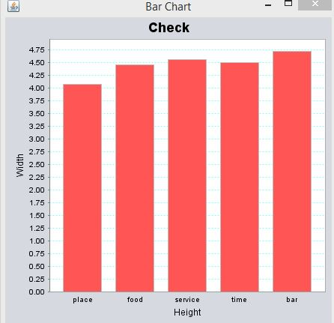
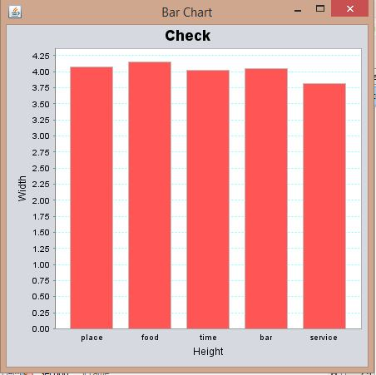
Comparison:
Before applying shingling technique
After applying shingling technique

Slide 12
Naïve Bayesian Classifier
Let's suppose the suspected message contains the word “subscribe". Most people who will read a review would know that this review is likely to be spam. The spam detection software, however, does not "know" such facts; all it can do is compute probabilities.
Pr(S|W) = Pr(W|S).Pr(S) / Pr(W|S).Pr(S) + Pr(W|H).Pr(H)
Of course, determining whether a message is spam or ham based only on the presence of the word is error-prone, which is why bayesian spam software tries to consider several words and combine their spamicities to determine a review's overall probability of being spam.

Slide 13
Naïve Bayesian Classifier (Continued)
On this basis, one can derive the following formula from Bayes‘ theorem
p = p₁p₂…….p_{N} / p₁p₂……p_{N} + (1 – p₁)(1 – p₂)…..(1 - p_{N})
The result p is typically compared to a given threshold to decide whether the message is spam or not. If p is lower than the threshold, the message is considered as likely ham, otherwise it is considered as likely spam.
Though, It has some exceptions.

Slide 14
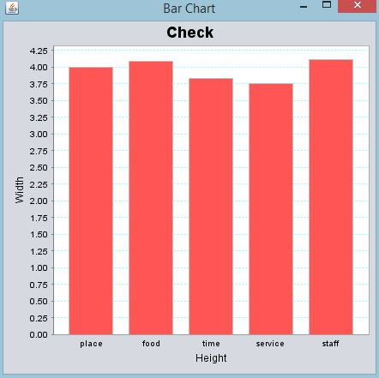
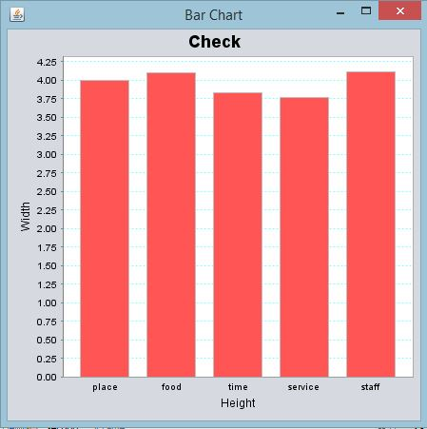
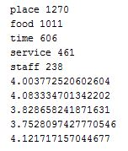
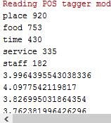
Original Ratings
Ratings after applying Bayesian classifier

Slide 15
Using reviewer history
We will use three fundamental concepts, i.e.
The trustiness of reviewers
The honesty of reviews
Reliability of the product
Identification of their interrelationships:
A reviewer is more trustworthy if (s)he has written more number of honest reviews,
Honesty of a review depends on 2 things –
Agreement in time frame `t`
Depends on Trustiness of the User
Reliability of the product
A product is more reliable if it contains more number of reviews from trustworthy user
We will initially fix values of trustiness of each user and reliability of each product to 1 and then iteratively calculate values till they converge

Slide 16

Basic Formulas Used
H_{r =} $\sum_{i=1}^{nr}{H(α)}$
T(User) = K/(1 + e^{-KH}_{r})
T(User) = T(User) - T(User) * (e^{-(x –1)})
R(P) = 2 / (1 + e-^{Q}) – 1

Slide 17

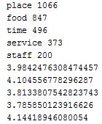
Original Ratings
Ratings after applying URH approach

Slide 18
Hybrid Model (Improved Review User History)
In this model we combined the scores from Bayesian Model and Review user history model. These scores were then compared to a threshold value of 10⁻⁵.
This model proved to be the better approach amongst all the models that we used.

Slide 19
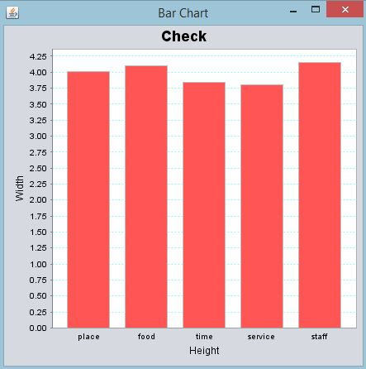
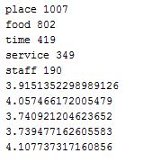
Original Ratings
Ratings after applying Hybrid Approach

Slide 20
Thank You

